Slide 1


Chat with your dataset
AutoRAG
Hafiz Ghazanfar Ahmad 2021-SE-16
Muhammad Afaq 2021-SE-18
M Saad Amjad 2021-SE-32
Wali Muhammad 2021-SE-39
Faqeed Hassan 2021-SE-54

Slide 2



AGENDA
1
Problem Statement
6
Business Model
2
Our Solution
7
Project Benefits
3
Workflow and Technology Overview
8
Why Invest in Our Project
4
Competitive Advantage
9
Roadmap and Future Plans
5
Market Opportunity
10
Conclusion

Slide 3

Problem Statement
Small businesses and freelancers struggle with fragmented tools.
Growing need for unified, efficient solutions with automation.
An end-to-end suit for conversational application development to deployment.

Slide 4

Unified Ecosystem
Simplify your workflow with an all-in-one platform combining file management, chatbot assistance, and collaboration tools.
Automation Pipeline
A single pipeline to create some conversational app specially for users' data. RAG assists with conversation with users' private data.
Our Solution
End-to-End Suit
From development to deployment an End-to-End Suit for non-technical person from no code experience.

Slide 5




Project Workflow
Step 1:
Step 2:
Step 3:
User answers simple questions for chatbot
Application setups an automation pipeline
User can chat with the bot and it can change it preference along with deployment and integration

Slide 6
Technology Stack
FRONTEND
BACKEND & DATABASE
React with Material UI for interactive interface
Node.js for robust functionality. Firebase for scalable storage.
LangChain
Chatbot Interface
LangChain for RAG App
Gradio/ejs for Chatbot interface

Slide 7
The Business Opportunity
Growing demand for AI tools due to increase in trend
All in one solution with automatic pipeline
Accessible to businesses of all sizes.
Serviceable Obtainable Market:
4$M
Serviceable Addressable Market: $11.7 M
Total Addressable Market: $184 M

Slide 8
REVENUE STREAMS:
MONETIZATION STRATEGY:
Subscription Plans:
Flexible pricing tiers (Basic, Premium).
Charges for Paid Services.
Add-On Services:
Additional revenue from extended storage, custom integrations, and premium support.
Implement subscription-based recurring revenue for predictable growth.
Upsell add-ons to cater to diverse user needs and maximize lifetime value .
Offer a licensing option for enterprises seeking long-term solutions.
AutoRAG

Slide 9

KEY COMPETITIVE ADVANTAGES
Time-Saving
AI-Powered Assistance
With integrated tools, users don’t waste time switching between platforms.
Our chatbot is available 24/7 to answer questions and help users stay organized
Affordable Pricing
Scalability
A solution designed to fit the budgets of individuals and small businesses.
Whether it’s a freelancer or a growing enterprise, our platform can adapt to their needs.

Slide 10
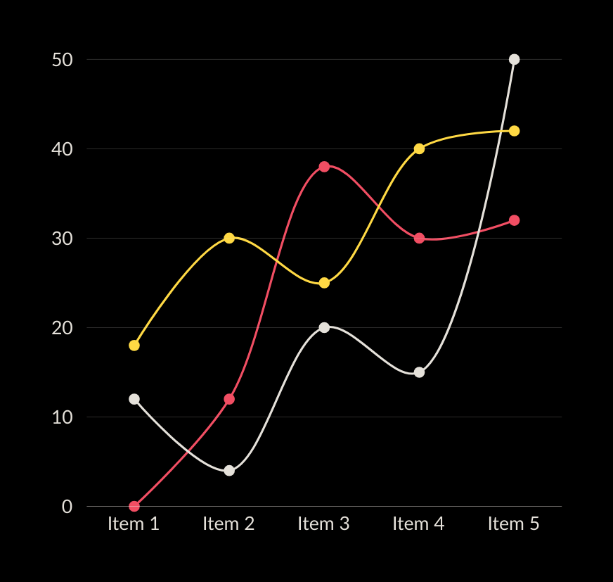
Why Invest in Our Project
Our unique selling points, like AI-driven chatbots and file management, give us a competitive edge. An investment in our project is not just about solving today’s problems—it’s about being part of tomorrow’s success.
Trending AI technology, High Market Demand
All in one solution with minimum effort
End-to-end Pipeline

Slide 11
REVENUE MODEL
Basic Plan
Standard Plan
Premium Plan
Pricing | Free | 75$/ month | 225$/ month
Features | Limited features Free tier services No customization | More features Standard support Some customization with paid services | Full features Priority support Full customization
Usage Limits | Live for 72 Hours Limited storage to 4.6Mb | Increased usage Live for up-to 30 days Storage up-to 200Mb | Unlimited usage Storage up-to 1GB
Additional Services | No additional services included | Optional add-ons available for purchase | Premium support and consulting included

Slide 12
ACCOMPLISHMENTS DATE
Present
2025
2026
2028
Prototype with basic functionalities for chatbot
Complete conversational app with CI/CD pipeline
Azure services for custom chabot hosting and persistence storage
Enterprise level application

Slide 13
Conclusion
Our platform addresses a critical market need by streamlining workflows and enhancing productivity for professionals and businesses. With innovative AI features, a scalable design, and a sustainable business model, we’re positioned to disrupt the productivity tools market. This isn’t just a solution for today’s challenges—it’s a foundation for future growth and success.

Slide 14
Chat with your own dataset
THANK YOU
for your time and attention

